Slide 1
JOURNEY
Larry Stybel
Stybel Peabody, a Lincolnshire Intl. Co.

Slide 2
-Psychologist
-Entrepreneur
-Leadership and Career Management

Slide 5
HR:

Slide 6
Politics:

Slide 7
Retail Grocery:

Slide 8
Auto Industry:

Slide 9
Retained Search:

Slide 10
CEO Reaction to the “Three Bs”

Slide 11
GOALS OF THIS RESEARCH
Journey of CHROs
Journey of GCs
Any differences?

Slide 12
RESEARCH PROCEDURE

Slide 13
MAJOR FINDING #1:

Slide 14
On a scale of zero (never) to 10 (always) how would you rate this person’s openness to new ideas?

Slide 16
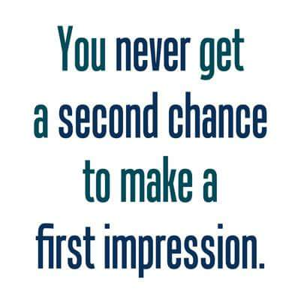
MAJOR FINDING #2

Slide 17
Onboard the New CEO to the Board of Directors

Slide 18
Implications:
What’s the FIRST thing you should address with your new CEO.

Slide 20
Major Finding #3

Slide 21
Implications
If you want to be a valued adviser, then be prepared to walk away if the reporting relationship is not to the CEO.
If you are in a Ghetto, understand the tradeoff between emotional comfort, logical access, and political influence. Example: my Neighborhood Outpatient Clinic Director was NEVER at the Clinic!
If you are in a Ghetto, be prepared to bring your laptop to the CEO’s office area and just be seen “hanging around.”

Slide 23
Major Finding #4:

Slide 24
Implications
Your theme should be “I’m not your typical ---.” Focus on what you learned from activities outside your area of expertise.
Common Example: “I’m not your typical ---. I have spent x years selling professional services.”

Slide 25
Major Finding #6

Slide 26
Implications:
When commenting, say “when I put my HR hat on…….” but “when I put my shareholder value hat on……”
Seek opportunities to blurr boundaries: follow sales professionals, eversdrop on customer support lines, hang around the R&D group and observe. Create opportunities for your staff to blurr.
Asked to be invited to meetings outside your specialty.
When financials come out, make sure you are asking questions about the business as a whole and the competitive environment.
Encourage your staff to blurr.

Slide 28
SUMMARY: From Head of a Business Function to ALSO Being Your CEO’s Valued Adviser.
Not Everybody CAN do it; Not everybody SHOULD do it.

Slide 29
SUMMARY: From Head of a Business Function to ALSO Being Your CEO’s Valued Adviser.
Candidates: is the CEO on the high end of “Openness to New Experiences?”
Are you insightful enough about yourself to know if YOU are on the high end?
In interviews stress how UNTYPICAL you are of your peers.
Does the position report directly to the CEO?
How far from the CEO’s office is your office?

Slide 30
SUMMARY: The Big Picture
“Say in Your Lane” is a mid 20th Century Framework.
Be outstanding in your specialty AND show you know how to blur.
Precisely Fuzzy.

Slide 31
SUMMARY: From Head of a Business Function to ALSO Being Your CEO’s Valued Adviser.
First Impressions Count: When dealing with a newly hired/promoted CEO, can you help the CEO onboard to the Board of Directors?

Slide 32
SUMMARY: From Head of a Business Function to ALSO Being Your CEO’s Valued Adviser.
Seek to managing the blurring of boundaries between HR and the rest of the business.

Slide 33
SUMMARY: From Head of a Business Function to ALSO Being Your CEO’s Valued Adviser.
Glad to send a copy of our PSYCHOLOGY TODAY article.
Glad to send a copy of these slides.
Glad to put you on the mailing list for our Special Interest Group: Journey Forum.
Glad to send you the mp3 of this talk.

Slide 35
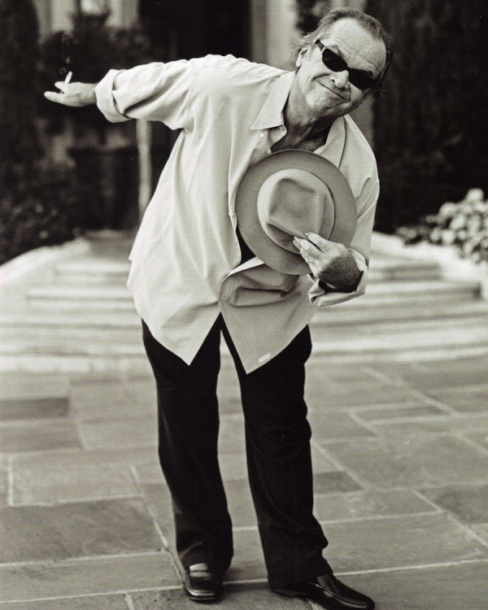
From Head of a Business Function to ALSO Being Your CEO’s Valued Adviser.

